Slide 1
Visualize Happiness
Team Member
Darren Raymond
Paul Anderson
Evan Mobley
Shreya Bakshi
Notes:
Hello everyone our Team worked on the Project to visualize Happiness in different countries

Slide 2
Objectives
Does freedom have an affect on happiness?
Which countries are the happiest?
Is happiness based on geography?
Does happiness is based on health life expectancy?
Is Happiness changing over Time?
Notes:
We looked for the objectives

Slide 3
Datasets to be Used
https://www.kaggle.com/mathurinache/world-happiness-report-20152021
https://data.world/samayo/country-names/workspace/file?filename=country-yearly-average-temperature.json
https://data.worldbank.org/indicator
Notes:
These were the data sets we used from Kaggle.

Slide 4
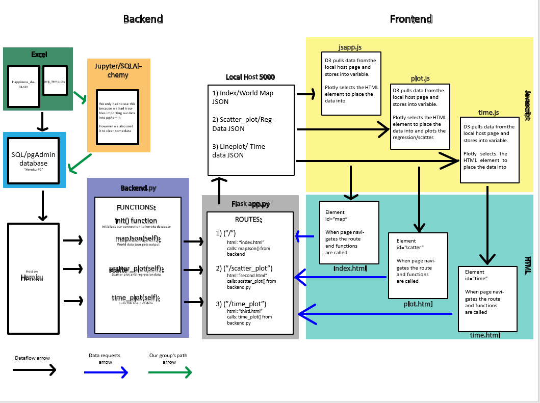
Project Data Flow

Slide 5
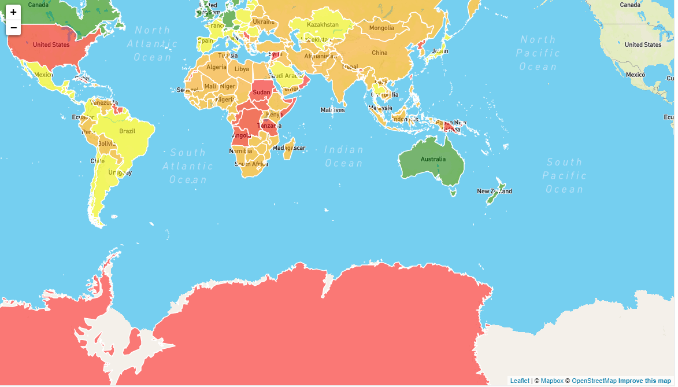
World Map where you can see each country's happiness score and rank

Slide 6
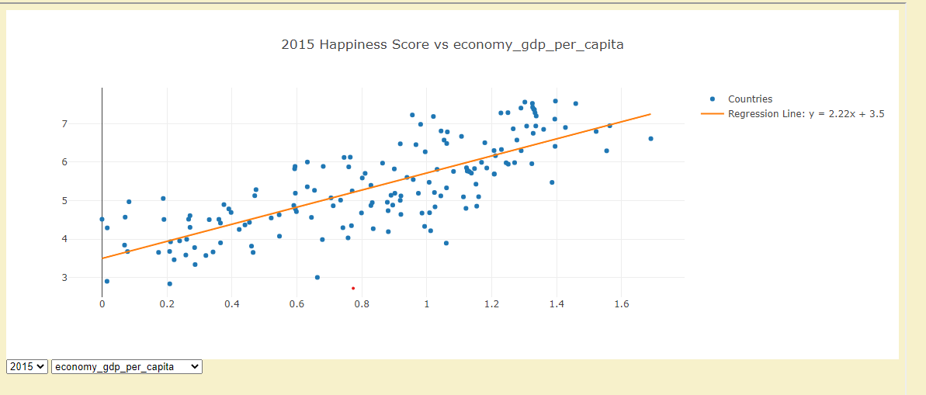
Happiness score

Slide 7
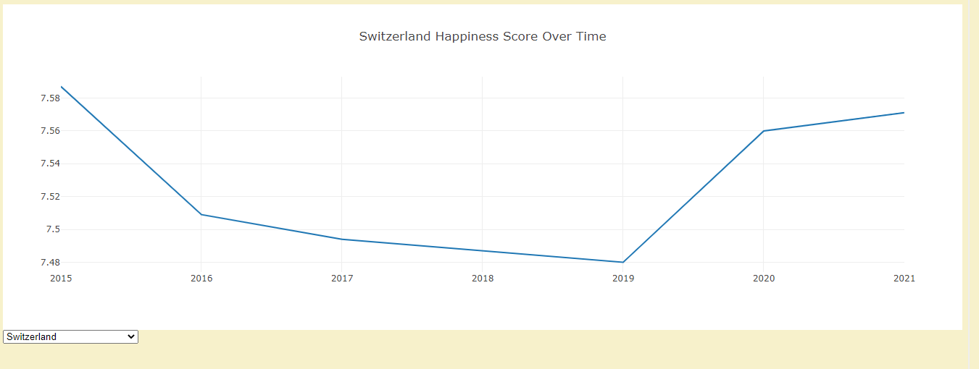
Happiness over Time

Slide 8
Thank You

